Slide 1
IB PARENT COFFEE Sept 21 & 29, 2020 via Zoom
Presented by the Desert Mountain International Baccalaureate parent Association
DM IBPA

Slide 2
What is IBPA?
IB Parent Association is a non-profit organization run by parent volunteers who support the students, their families and teachers in the DMHS IB DP and IB MYP programs and is solely funded by donations.
How does IBPA do this?
The IBPA focuses on building a community around the IB Programs by:
Funding “enrichment tools” for IB classes
Creating IB social events
Hosting Parent Education sessions
Orchestrating the IB Recognition Event
Supporting the IB Administration with their needs

Slide 3
2020-21 IBPA Board Volunteers
Chair
Secretary
Treasurer
Communications
Chair-Hospitality & Teacher Requests
Chair-Fundraising
Chair-IB Recognition Event
Proctoring Coordinator
Miyako Ichikawa - IB Senior
Regina de Jong - IB Junior
Rebecca Smith - IB Junior
Sara Persson - IB Junior & Sophomore
Dina Cohen - IB Senior
Allison Heron - IB Junior
Charu Kaiwar - IB Junior
Sara Persson
…. and YOU! Yes, we need you!
We make it easy … Just ”Shadow” this year

Slide 4
2020-21 IBPA Events
Aug 14: IB Freshman Game Night by IBSA
Sept 21: IB Parent Coffee
Sept 29: IB Parent Coffee
Oct 22: Parent Ed “How to Speak IB”
Fall: Parent Ed “CAS Explained”, guest speaker frm IB Administration (Tentative)
Oct-Dec: IB Parent Coffee
By end of 1st semester: IB Student Social (Collaboration with IBSA)
Tentative
Jan-Feb: “Life after IB: Thoughts & Advice from IB Alums”
Jan-Feb: IB Parent Coffee
TBD: IB Student Social (Collaboration with IBSA - Think ”IB BALL”!)
May: IB Recognition Event

Slide 5
Guest Speaker
IBSA is a club for IB students of all grades
Create connections
Active through multiple committees
First Fridays
Big Buddies, etc
To join:
Text @joinibsa to 81010
Google classroom - czwitgr
Sasha Harikumar
IB DP Senior
IBSA – Big Buddies Committee

Slide 6
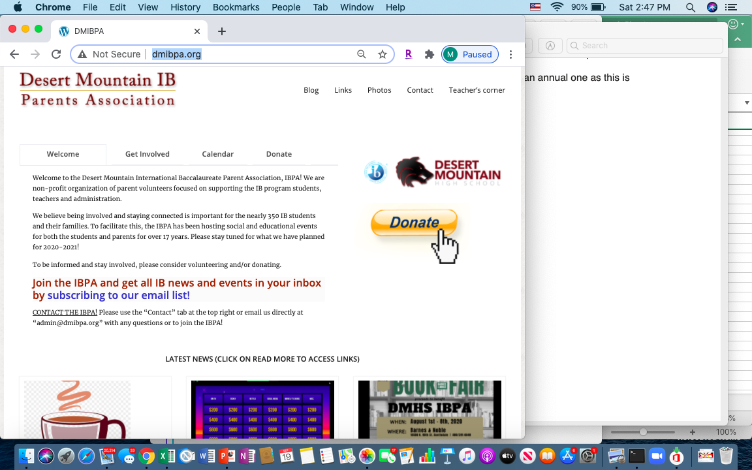
Let’s Stay Connected!
Our IBPA Website: dmibpa.org

Slide 7
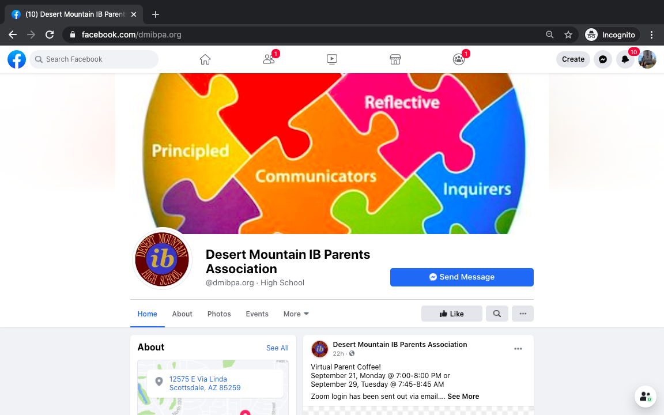
Let’s Stay Connected!
Our Facebook Page: dmibpa.org

Slide 8
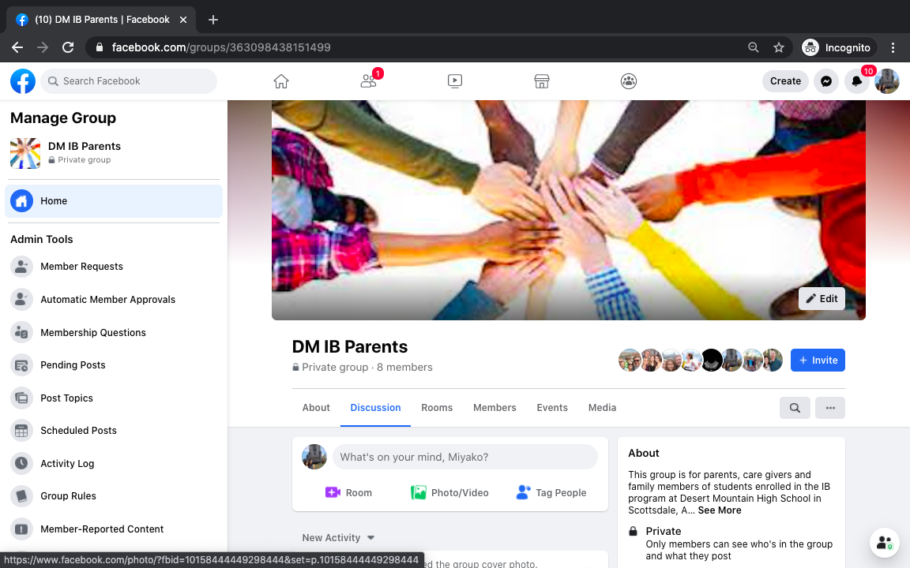
Let’s Stay Connected!
Our Facebook Group: DM IB Parents

Slide 9
How do I join IBPA?
Have a student in IB MYP or DP? You are already a part of IBPA!
An annual $30 donation is suggested.
Your IBPA donation can be accepted through our website…
Our IBPA Website: dmibpa.org

Slide 10
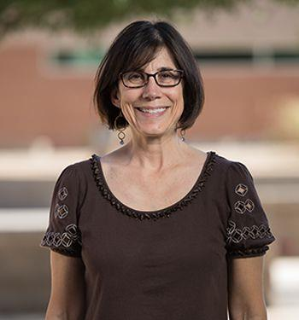
Guest Speaker
Dr. Lisa Hirsch
DMHS Principal
IB FAQs

Slide 11
Website: dmibpa.org
Page: dmibpa.org
Group: DM IB Parents
IBPA
Twitter: @dmibpa
Instagram: dmibpa
Thank you!

